Slide 1
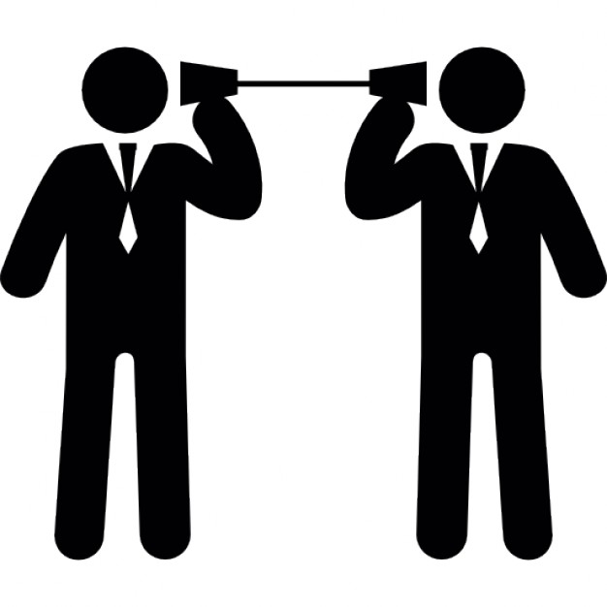
A Communication Strategy for the College of Computer Training (CCT)

Slide 2
Purpose of this presentation
Demonstrate the importance of effective communication and its’ benefits
Outline a strategy for optimising the communication sources, methods and infrastructure here at CCT
The need for feedback and an efficient approach here at CCT
The way we communicate with others and with ourselves ultimately determines the quality of our lives.
~Tony Robbins

Slide 3
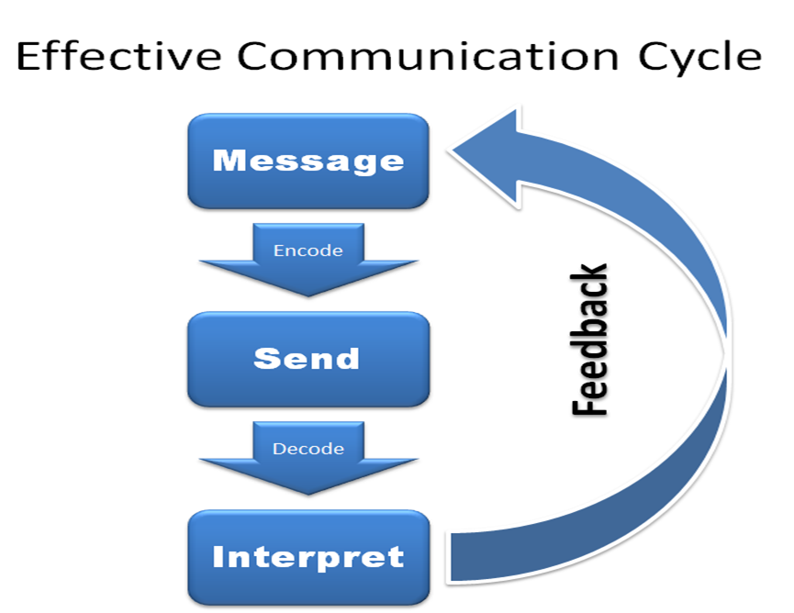

Slide 4
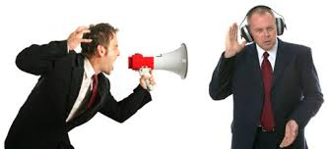

Benefits of effective communication
Effective communication is a two-way street
It’s not only how you convey a message so that it is received and understood by someone in exactly the way you intended
It’s also how the message is heard and understood

Slide 5

Importance of effective communication
Meerkats?
Feedback is key
Message is heard
Message is understood
No problems
"If words of command are not clear and distinct, if orders are not thoroughly understood, then the general is to blame."
~Sun Tzu

Slide 6
So how does this apply to us?
Two-way-communication
Allows for feedback
Ensures the message is understood
Allows for improvements in the message; its’ content and its’ delivery

Slide 7
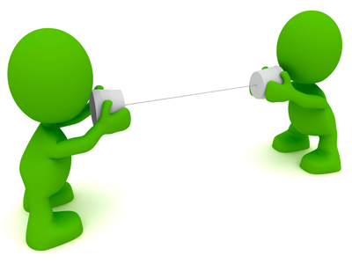
Methods for communication
1. Written
2. Spoken
3. Visual
4. Technological
5. Mass Media

Slide 8

Why is a Technological method our best choice?
Quicker problem solving
Better decision making
Steady work flow
Strong business relations
Better Professional image
Ensure familiarity with basic IT skills necessary to thrive

Slide 9
How do stakeholders benefit from this choice?
Immediate communication ensures students, staff and external stakeholders are all up-to-date
Two-way communication provides instant feedback
Reduced costs allow funds to be spent on
  increased wages for staff
  basic intro to IT for all new students
  investment in infrastructure for all stakeholders

Slide 10
So where does this lead us?
Email, email, email!
Facebook
Instant messaging
    Cross-platform support with smartphones
Local portal

Slide 11


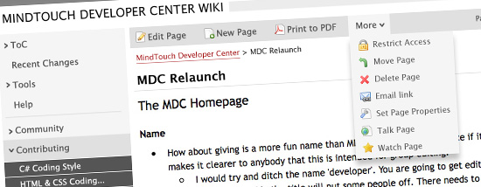

But the money?!?
Open source dummy
Students become task owners
Tasks provide meaningful impact
Have fun with it!

Slide 12

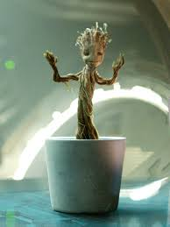
Key adoption strategies
It’s not impossible, it’s necessary!
    Modern business requires basic IT communication skills
  Environmental factors
    Why do you hate trees?
Incorporate learning with doing!
    Huge resource available for the development and maintenance of these tools

Slide 13
Questions?

Slide 14

Thank you.

